Slide 1
Analytics Server, Data Management and Storage
Feb 28, 2018

Slide 2
Objectives
Step 1: Determined the building blocks
Capacity： CPU, memory, Storage
Connectivity: bridges to existing server/data/service
Compatibility: legacy models, version control
Compliance: HIPAA
Step 2: Collected feedback and opinion from ACE staff
Step 3: Constructed a list of comprehensive requirements for development and sandbox server

Slide 3
Production & Sandbox server
New production & sandbox server are extensions to existing server, with more recent tools/languages installed
It will maintain general access to existing data (MarketScan, NIKE)
It will maintain general access to existing server (0852, 1465)
Legacy models will keep running on existing server until they are ready to be transitioned into new servers
Future models will be tested, stored and produced on new production & sandbox server

Slide 4
Production vs. Sandbox server
 | Production | Sandbox
Timing | Early February | Upon finishing Production server
Data restrictions | General HIPAA | General HIPAA
3rd party software | Docker*, Flexible Analytics | Docker*, Flexible Analytics, Anaconda Python(2.7 and 3.6: pandas, numpy, sklearn), R and Rstudio, SQL, Git, Git LFS, Jupyter Notebook, Spark, SAS(?)
Access/users | Restricted access to and control by project/production lead | Restricted and unrestricted access to and control by ACE users

Slide 5
Production vs. Sandbox server
 | Production | Sandbox
CPU | 24 | 8 per user
Storage | 4-8TB (must be scalable) | 1-2TB (must be scalable)
RAM | 64-128GB | 16-32GB per user (roughly 10 at a time)
Operating system | Linux 64-bit (Redhat or minimal install CentOS 7) | Linux 64-bit (Redhat or minimal install CentOS 7)
Path to existing server/model | SFTP tunnel | SFTP tunnel
Data access | Explorys, MarketScan, SAF, Huntmore(CED), PIDB, reference data | Explorys, MarketScan, SAF, Huntmore(CED), PIDB, reference data

Slide 6
Solution 2: cloud servers
Pros | Cons
No need for onsite hardware or capital expenses. Well suited to rapidly growing companies that may outgrow their infrastructure too quickly. | The user experience is limited by the speed of the Internet connection.
Easily scalable; can be added to as needed. Solutions are often on-demand, so you only pay for the options you want. | Third party cloud services could have direct access to your data.
Workers can connect from anywhere, using any computer, tablet, or smartphone. Companies can implement BYOD (bring your own device) policies. | If the Internet goes down on your side or on your cloud provider’s side, you won’t have access to any of your information.
Data can be backed up in the cloud as regularly as 15-minute intervals, minimizing data losses in disaster situations. | The costs can outweigh the benefits for companies not as dependent on uptime.

Slide 7
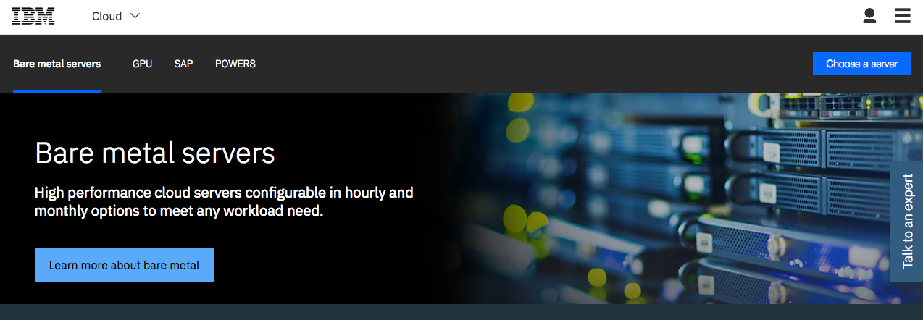
IBM cloud server

Slide 8
IBM cloud server
Intel Xeon E5-2690 v4: $1500/month (additional 30% IBM internal discount)
Configure to our demand
HIPAA compliant
28 cores, 2.60 GHz
256GB RAM, 10TB storage
Point of contact: wnichola@us.ibm.com

Slide 9
Current Status- “DEV” and “SANDBOX” servers
Received “Dev” server about 4 weeks ago. The CCM Medicaid team has access and will be using it for analytic code testing for large data sample. The team will also use this server to do final testing, wrap code in docker file before shipping it to Flexible Analytics for deployment. Access to all other team members will be provided soon
Received “Sandbox” server early this week. There is currently no data or tools or packages loaded on this server. Sometime this week, once approval is received to copy data for SDoH project from 0852 server, packages and data used for SDoH will be copied and loaded to the sandbox server as this project is deemed high priority. The timeline for this to happen is sometime this week. The SDoH team can start back their work in the new server. I have asked for access for the SDoH team.
Rajashree will forward instructions to request access to the sandbox server. Managers can request access for each of their team members.

Slide 10
Short and Long Term Approaches for Data Management and Storage
Short Term Approaches
Copy all needed data to sandbox server- MarketScan, SAF etc with appropriate approvals from Data Governance
Run SAS queries on 0852 or NIKE servers, create csv files and SCP to sandbox for analytic work, again with appropriate approvals from Data Governance
Medium to Long Term approaches
Network-attached storage (NAS) : A Network Attached Storage (NAS) device is a storage device connected to a network that allows storage and retrieval of data from a centralized location for authorized network users. The idea is to have a copy of MarketScan, SAF data etc onto the NAS so that all the users in ACE team can access those files . One of the main advantage is we can access the files from any Truven servers (0852 ,3131,1465 etc).

Slide 11
Short and Long Term Approaches for Data Management and Storage
Medium to Long Term approaches
Apache Hive: The Apache Hive data warehouse software facilitates reading, writing, and managing large datasets residing in distributed storage using SQL. It is built on top of Apache Hadoop. Look into creating hive tables out of the MarketScan and other data sets and have these tables reside in Hadoop Server. The main advantage is we can process large data sets in short amount of time and transfer the processed output to the Sandbox server (3131) using SCP.
DB2: DB2 is a database product from IBM. It is a Relational Database Management System (RDBMS). DB2 is designed to store, analyze and retrieve the data efficiently. One option is to move data into DB2 . The DB2 instance will be created on Hadoop Server. We can contact Gigi's team to discuss about this option since they have transferred some of the MarketScan data into DB2. DB2 is not free & we need to get an estimate of the costs and resources needed to move the MarketScan data into DB2. IBM Db2 Big SQL : https://www.ibm.com/us-en/marketplace/big-sql

Slide 12
Access to EMR Data
No change from current access or process

